Slide 1

Programmable forwarding planes are here to stay
Nick McKeown
Stanford University

Slide 2
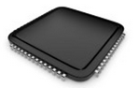
OSPF
BGP
etc.
Switch OS
Driver
Notes:
But first, I’d like to start with a cartoon picture that I’ve used many times, to motivate why programmable forwarding planes change how we think about building networking systems.
This is a cartoon picture of the insides of an enterprise switch or router. It runs a switch OS – which today is almost always based on Linux or BSD Unix.
The Switch OS talks to the switch ASIC via a Driver.
For every protocol and feature, there is a user-level process that exchanges routing table information with neighboring switches.
Today, this is pretty much how all network switches and routers are built.

Slide 3
OSPF
BGP
VXLAN
etc.
Switch OS
Driver
Notes:
Now imagine it’s 2010, and customers are asking for VXLAN. VXLAN was a new way to tag packets in virtualized data centers to identify the tenant the packets belong to.
The equipment vendor needs to write the VXLAN software to control the switch; and they need to update the driver to be able to add and delete entries in the switch ASIC.
This is a few weeks or at most a few months work.
They also need to update the switch ASIC, because VXLAN requires processing packets in new ways, and requires new lookup tables.
In the case of VXLAN, updating the switch ASIC took 4 years!
That’s right, it took 4 years to show up in the switch chips used to build switches and routers.
Let’s remember, this isn’t for some niche low priority feature.
This was in the most profitable, most invested-in part of networking.

Slide 4
Feature
Software
Team
Feature
Network Owner
Network Equipment Vendor
Weeks
Feature
ASIC
Team
Years
Years
Notes:
Let’s think about what happens during those 4 years: First, the network owners have to identify the problem. They tell network equipment vendors like Cisco, Arista, Juniper, who then huddle at the IETF to figure out a solution and publish a new Internet RFC. They define the feature and the software team writes the software – perhaps a few weeks work.
But the chip takes much longer. The ASIC team or the ASIC vendor need to believe the RFC is stable and commercially viable, to risk investing 10s of millions of dollars building a new ASIC.
Then they start to design a new chip with the new feature. 2-3 years later the new feature is available.
And then finally, after all this time, if we want to get the new feature, we have to buy new network equipment.

Slide 5
When you need a new feature…
Equipment vendor can’t just send you a software upgrade
New forwarding features take years to develop
By then, you’ve figured out a kludge to work around it
Your network gets more complicated, more brittle
Eventually, when the upgrade is available, it either
No longer solves your problem, or
You need a fork-lift upgrade, at huge expense.

Slide 6

Network systems are built “bottoms-up”
Switch OS
Driver
“This is how I process packets …”
Fixed-function switch

Slide 7
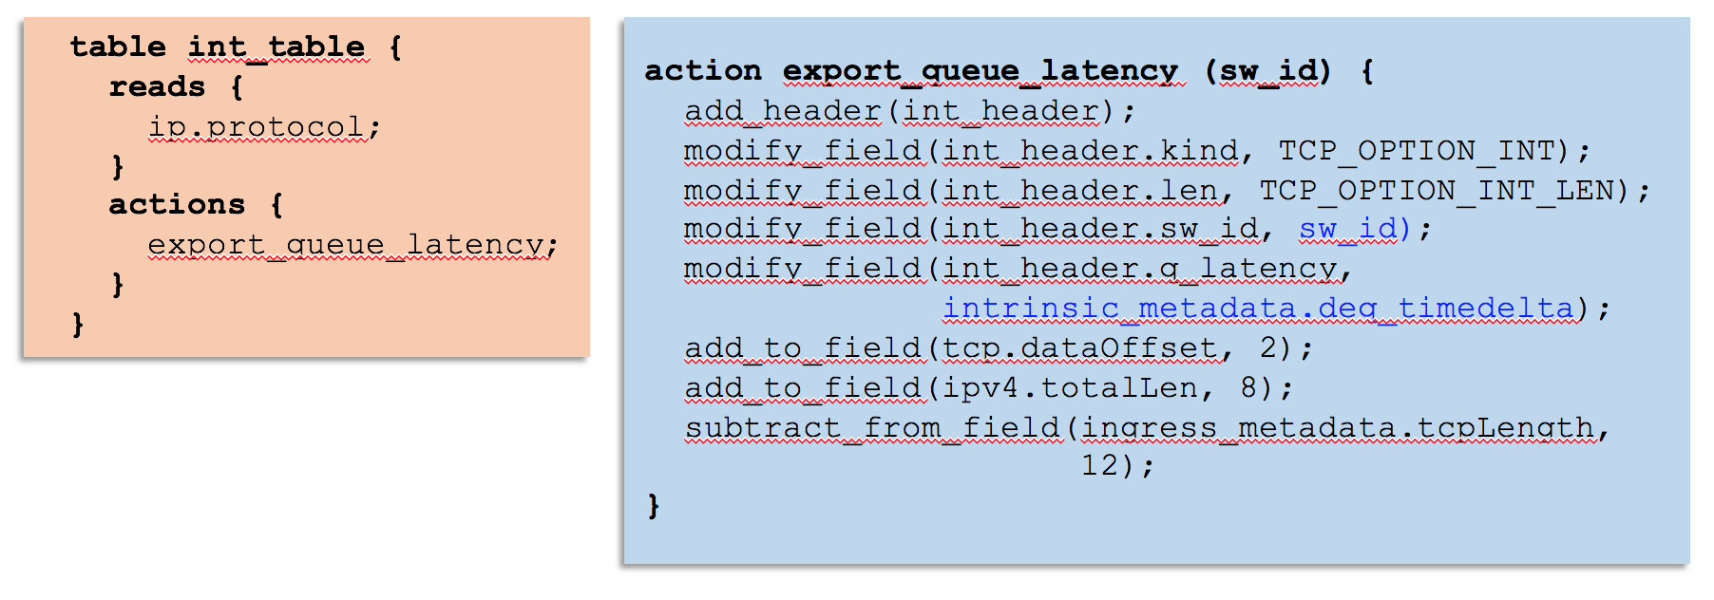
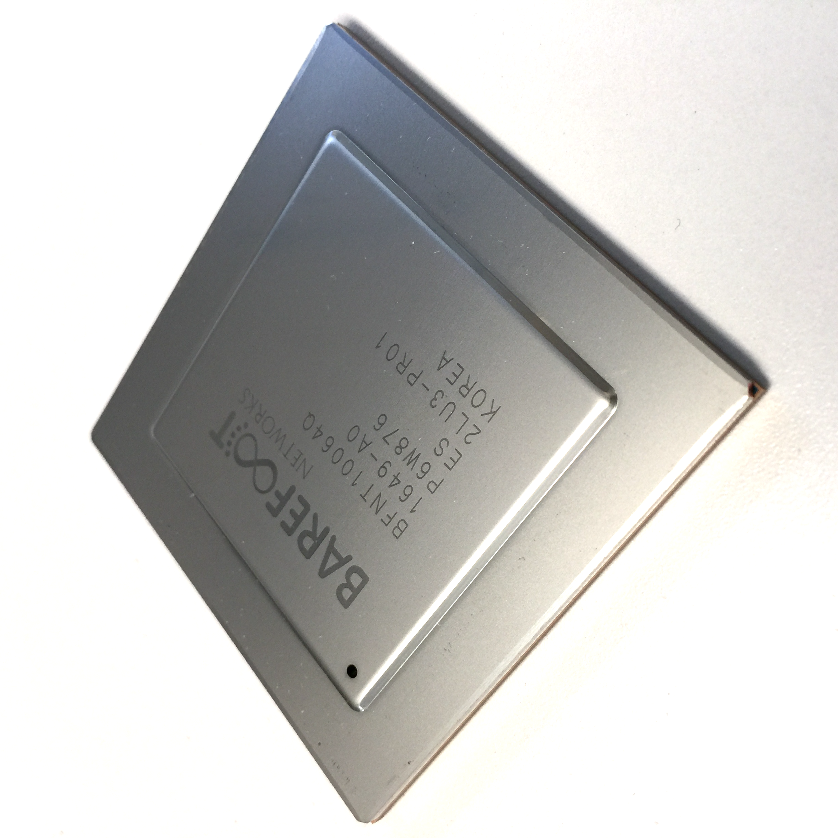
Network systems are starting to be programmed “top-down”
“This is precisely how you must process packets”
Switch OS
Driver
Programmable Switch
Notes:
And so one way to think about what the P4 movement is doing – is to turn the way we design network systems on its head. Our goal is to enable anyone who builds network systems to program the system “top-down”, by telling the forwarding plane precisely the behavior they want. Just like I can do on my computer.
It seems kind of obvious that this is what we want to do. So it begs a question: Why weren’t they all built this way?

Slide 8
Outline
Why programmability is happening now
How programmability is being used
Subtract features: Reducing complexity
Add proprietary features: Invent, differentiate, own
Silicon independence: Breaking a lock-in
Telemetry and measurement
Why programmability now from an ASIC technology viewpoint

Slide 9
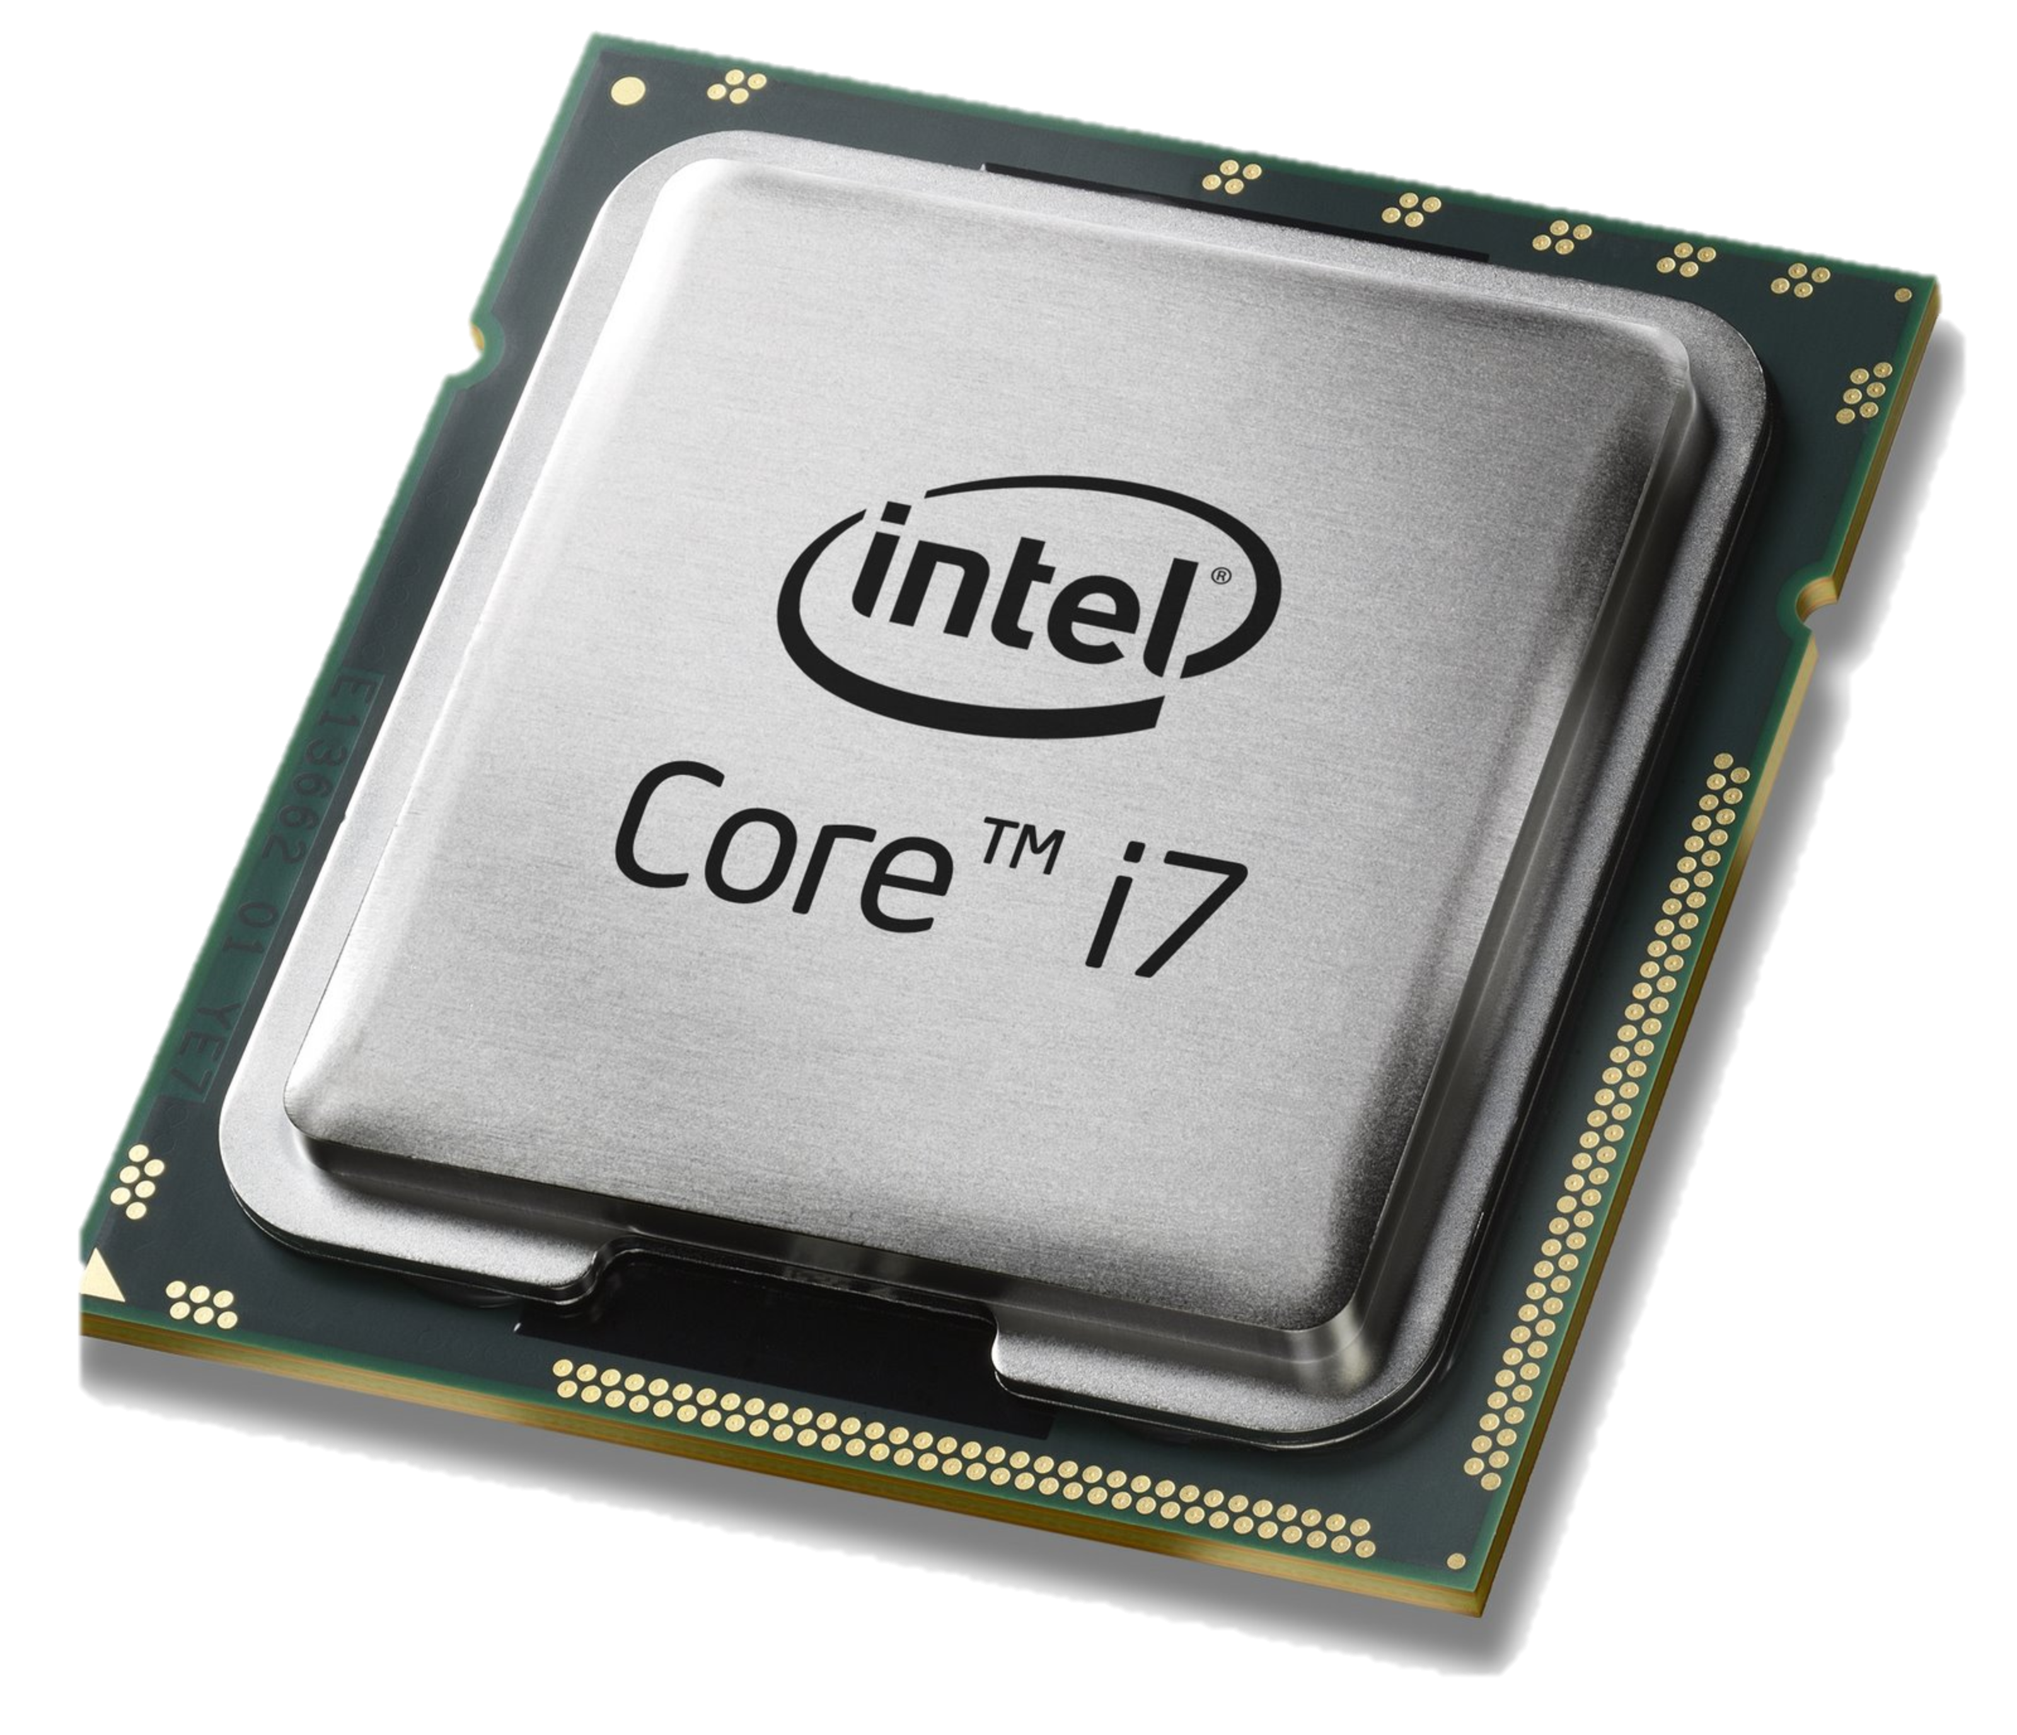
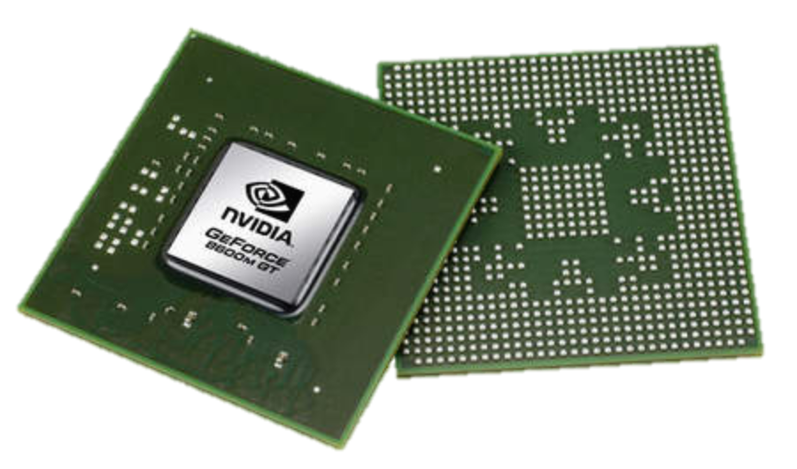
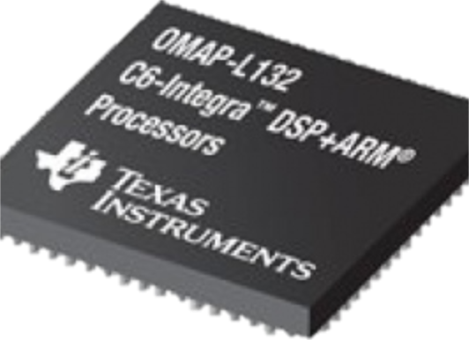
Domain Specific Processors
Signal
Processing
Machine
Learning
Computers
Graphics
Networking
Java
OpenCL
Matlab
TensorFlow
>>>
Language
Compiler
Compiler
Compiler
Compiler
Compiler
?
?
CPU
GPU
DSP
TPU
Notes:
One big reason is that networking has been kind of living in the dark ages, and is only now catching up with other areas of the industry.
Other domains solved this problem by designing their own domain-specific processors. I’m old enough to remember big fixed function graphics cards from folks like Sun, DEC and HP. Today, graphics is done in domain specific processors called GPUs. <show GPU>.
And I remember when signal processing for base-stations and video codecs was built using fixed function hardware. Today, it’s done in digital signal processors or DSPs. <show DSP>
In both cases, the user writes an application in a high level easy to use language, which is compiled down to run on the domain specific processor with the right instruction set, and the right model of parallelism.
The same thing is happening now in machine learning with TPUs <show TPU>.
This hasn’t happened in networking, because no-one stepped back and asked how to build the right domain-specific processor for processing packets.

Slide 10
Domain Specific Processors
Signal
Processing
Machine
Learning
Computers
Graphics
Networking
Java
OpenCL
Matlab
TensorFlow
>>>
P4
Compiler
Compiler
Compiler
Compiler
Compiler
?
CPU
GPU
DSP
TPU
PISA

Slide 11
PISA: Protocol Independent Switch Architecture
Programmer declares which
headers are recognized
Programmer declares what
tables are needed and how packets are processed
Match+Action
Memory
ALU
Programmable
Parser
All stages are identical – makes PISA a good “compiler target”
Notes:
PISA chips are also built around a pipeline. But in PISA, all the pipeline stages are all IDENTICAL. They initially don’t know anything about protocols – they are sitting waiting to receive instructions from the compiler.
The basic operations of each stage is called “Match + Action” – In each stage, there is a set of memories which match on headers,
Depending on the match, an action is applied to the header by an ALU. And then the header is passed to the next stage, and so on.
A PISA chip is initially blank – it doesn’t know about any protocols.
The P4 programmer tells the programmable parser what packet headers it should recognize.
If a new header is developed, we add it to the set of headers the parser recognizes.
Let’s take a closer look at how a packet is processed …..

Slide 12
PISA: Protocol Independent Switch Architecture
Programmable
Parser

Slide 13
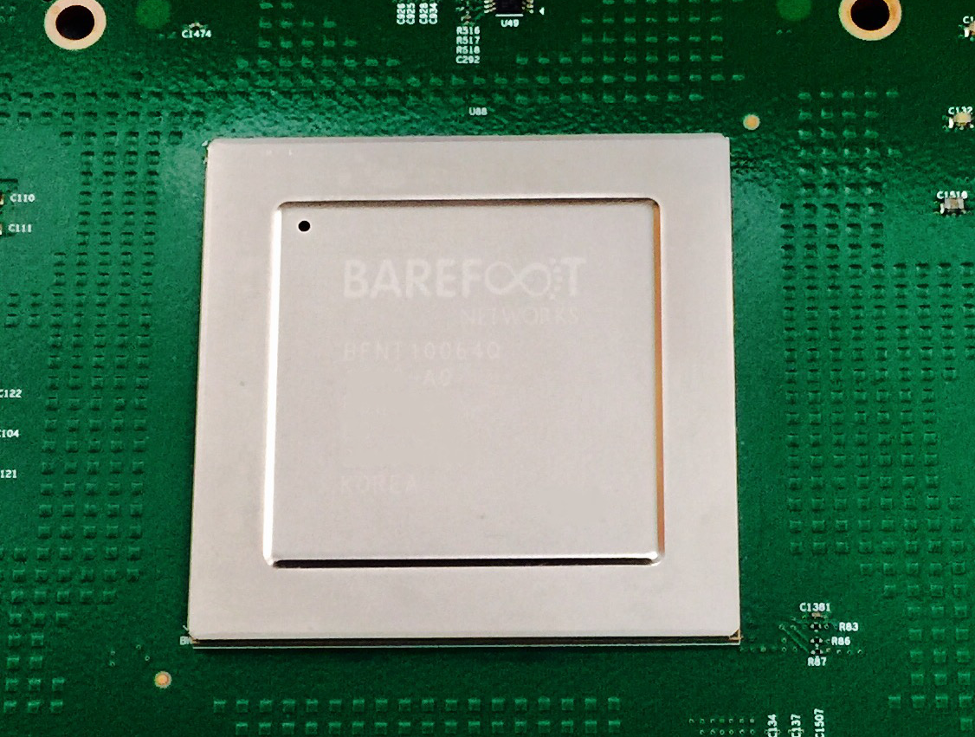
Tofino 6.5Tb/s Switch December 2016
65 x 100GE (or 260 x 25GE)
Same power and cost as fixed-function switches.

Slide 14
Outline
Why programmability is happening now
How programmability is being used
Subtract features: Reducing complexity
Add proprietary features: Invent, differentiate, own
Silicon independence: Breaking a lock-in
Telemetry and measurement
Why programmability now from an ASIC technology viewpoint

Slide 15
How programmability is being used
Reducing complexity
1

Slide 16
Reducing complexity
switch.p4
Switch OS
Driver
IPv4 and IPv6 routing
- Unicast Routing
- Routed Ports & SVI
- VRF
- Unicast RPF - Strict and Loose
- Multicast
- PIM-SM/DM & PIM-Bidir
Ethernet switching
- VLAN Flooding
- MAC Learning & Aging
- STP state
- VLAN Translation
Load balancing
- LAG
- ECMP & WCMP
- Resilient Hashing
- Flowlet Switching
Fast Failover
– LAG & ECMP
Tunneling
- IPv4 and IPv6 Routing & Switching
- IP-in-IP (6in4, 4in4)
- VXLAN, NVGRE, GENEVE & GRE
- Segment Routing, ILA
MPLS
- LER and LSR
- IPv4/v6 routing (L3VPN)
- L2 switching (EoMPLS, VPLS)
- MPLS over UDP/GRE
ACL
- MAC ACL, IPv4/v6 ACL, RACL
- QoS ACL, System ACL, PBR
- Port Range lookups in ACLs
QOS
- QoS Classification & marking
- Drop profiles/WRED
- RoCE v2 & FCoE
- CoPP (Control plane policing)
NAT and L4 Load Balancing
Security Features
- Storm Control, IP Source Guard
Monitoring & Telemetry
Ingress Mirroring and Egress Mirroring
Negative Mirroring
Sflow
INT
Counters
Route Table Entry Counters
VLAN/Bridge Domain Counters
Port/Interface Counters
Protocol Offload
- BFD, OAM
Multi-chip Fabric Support
- Forwarding, QOS
Compiler
Programmable Switch

Slide 17
Reducing complexity
My switch.p4
Switch OS
Driver
Compiler
Programmable Switch

Slide 18
How programmability is being used
Adding proprietary features
2

Slide 19
Protocol complexity 20 years ago
Ethernet
ethtype
ethtype
IPv4
IPX
Notes:
Back in the 1990s, a switch chip only needed to support 2 or 3 protocols.

Slide 20
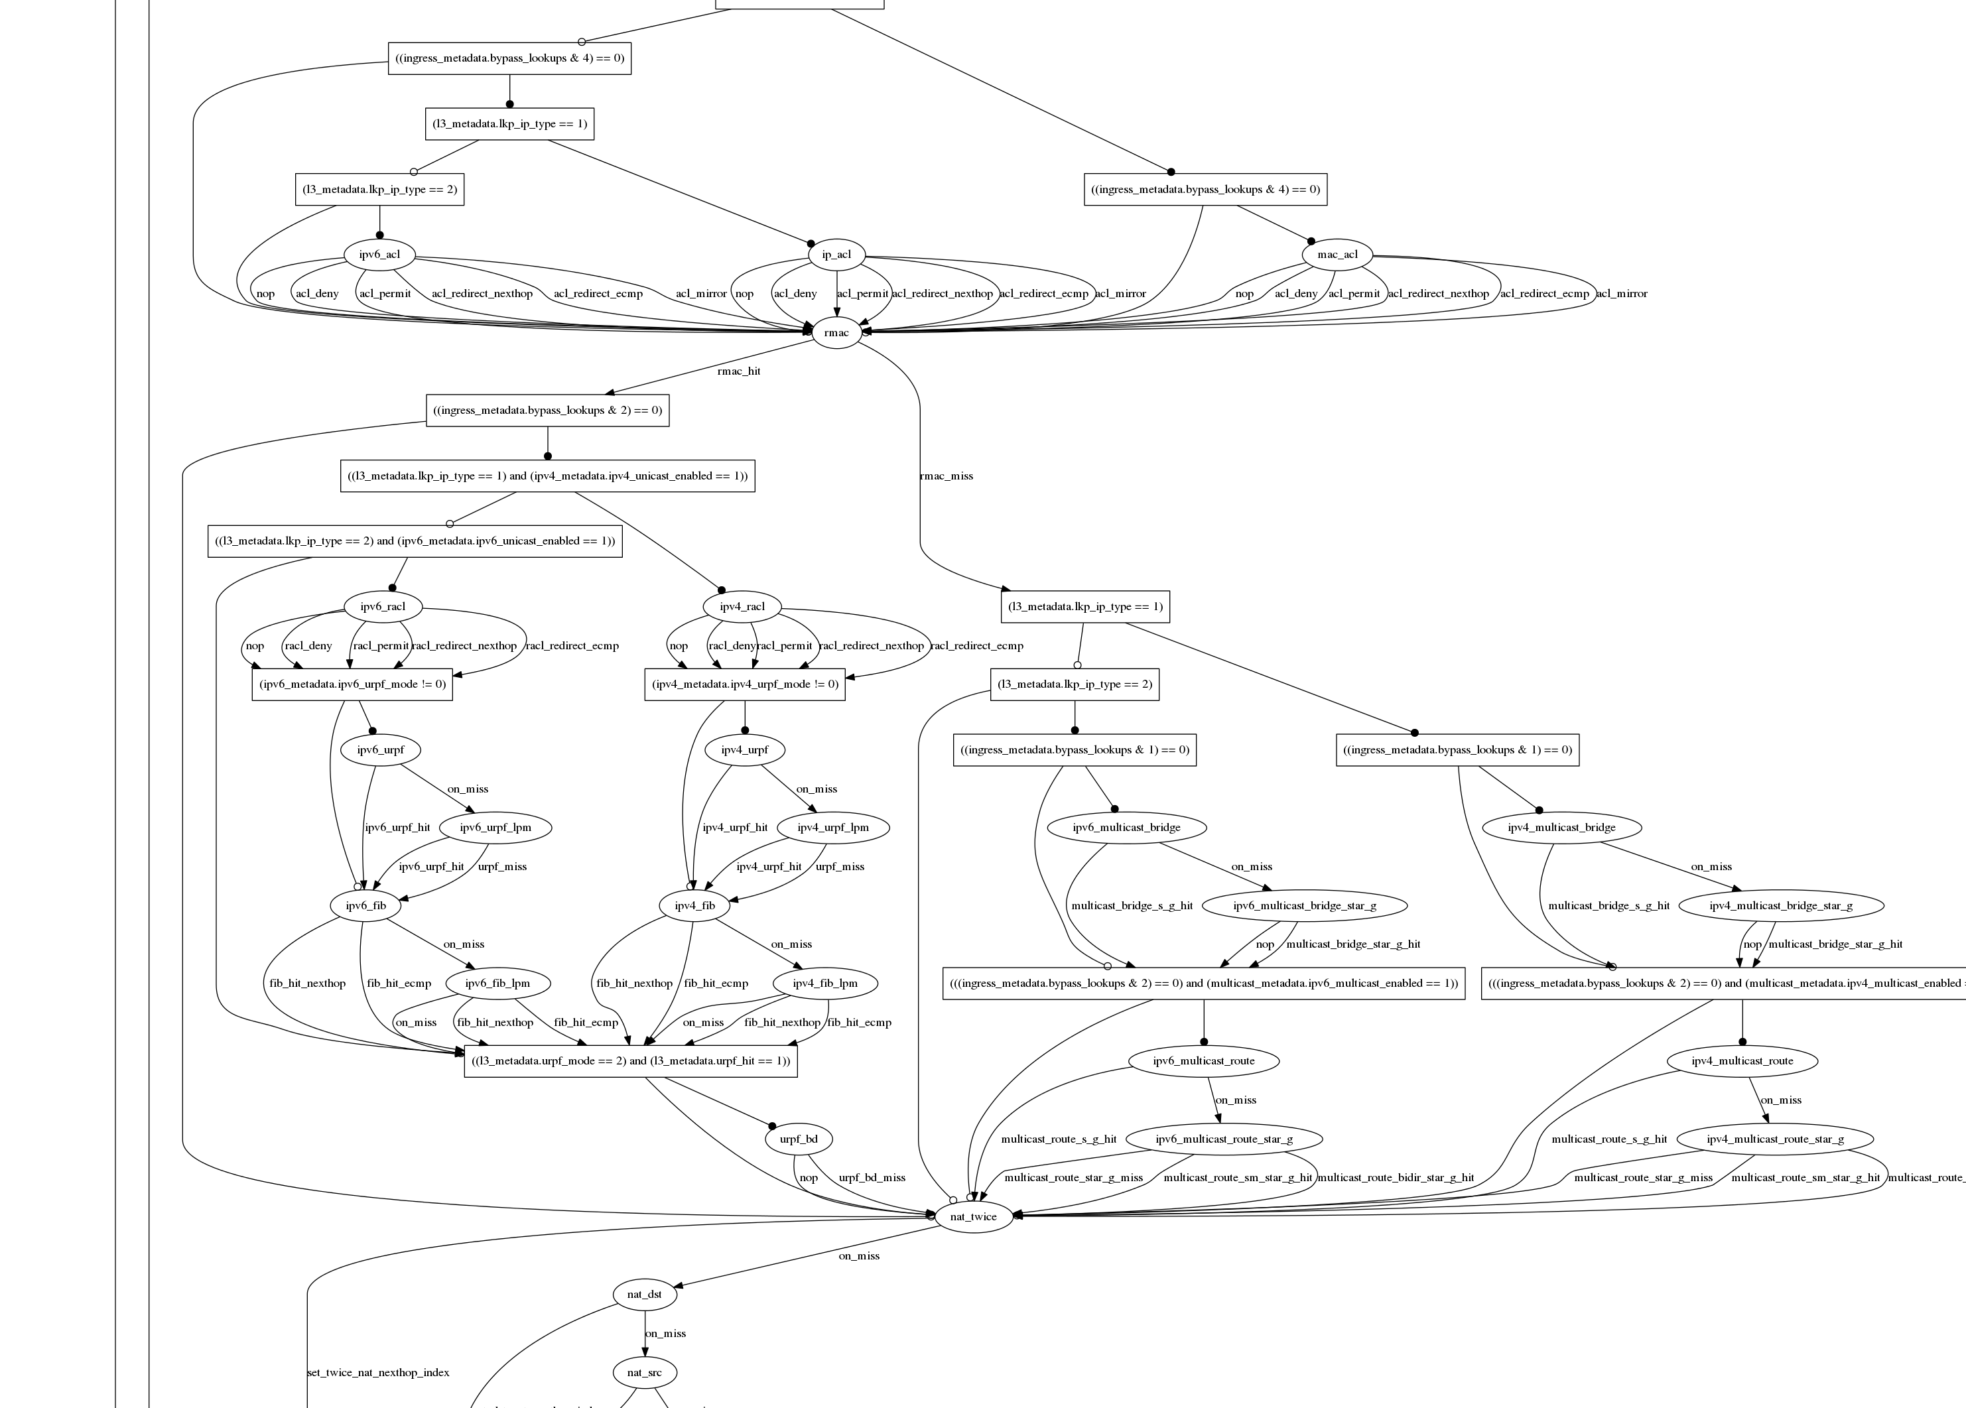
Datacenter switch today
switch.p4
Notes:
Today, it needs to support dozens. This is the typical set of protocols supported in a data center top of rack switch today. It is getting almost impossible to design fixed function chips with all the protocols, and to get it right.
If the chip is programmable, the chip design is much simpler. Complicated protocols are just programs written later by the user.
You can see how switch chips get more uniform as they become more programmable.

Slide 21
Adding features: Some examples so far
New encapsulations and tunnels
New ways to tag packets for special treatment
New approaches to routing: e.g. source routing in MSDCs
New approaches to congestion control
New ways to process packets: e.g. processing ticker-symbols

Slide 22
New applications: Some examples so far
Layer-4 Load Balancer¹
Replace 100 servers or 10 dedicated boxes with one programmable switch
Track and maintain mapping for 5-10 million http flows
Fast stateless firewall
Add/delete and track 100s of thousands of new connections per second
Cache for Key-value store²
Memcache in-network cache for 100 servers
1-2 billion operations per second
[1] “SilkRoad: Making Stateful Layer-4 Load Balancing Fast and Cheap Using Switching ASICs.” Rui Miao et al. Sigcomm 2017.
[2] “NetCache: Balancing Key-Value Stores with Fast In-Network Caching”, Xin Jin et al. To appear at SOSP 2017

Slide 23
How programmability is being used
Silicon independence
3

Slide 24
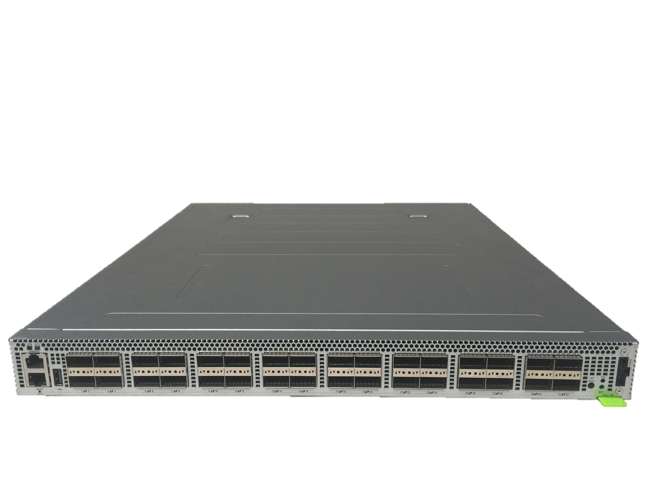
P4 Runtime Open-source project to remotely control P4 switches¹
Remote Control Plane
P4 Runtime
P4 Runtime
P4 Runtime
P4 Runtime
P4 Runtime API is:
Silicon Independent
Program Independent
OpenConfig
OpenConfig
OpenConfig
OpenConfig
gRPC
gRPC
gRPC
gRPC
Top of Rack
P4 Switches
P4 Runtime
P4 Runtime
P4 Runtime
P4 Runtime
Switch OS
Switch OS
Switch OS
Switch OS
[1] “P4 Program-dependent Controller Interface for SDN Applications”, Samar Abdi et al (Google), P4 Workshop 2017

Slide 25
How programmability is being used
Network telemetry
4

Slide 26
“I visited Switch 1 @780ns, Switch 9 @1.3µs, Switch 12 @2.4µs”
1
“Which path did my packet take?”
# | Rule
1
2
3
…
75 | 192.168.0/24
…
“In Switch 1, I followed rules 75 and 250. In Switch 9, I followed rules 3 and 80. ”
2
“Which rules did my packet follow?”
Notes:
But if we want to have complete visibility into exactly what our network is doing, all the time, then we need to answer four questions.
First: Which path did my packet take? I want every packet to tell me which switches it visited and when, to the nanosecond.
Second: When it passed through the switches, which rules did it match on? I want every packet to tell me which rules it matched on along the way, so I can tell exactly why it reached this point.

Slide 27
3
“How long did my packet queue at each switch?”
“Delay: 100ns, 200ns, 19740ns”
Queue
4
“Who did my packet share the queue with?”
Time
Notes:
Third: How long did my packet spend in the queue at each switch along the way? I want every packet to tell me how long it was sitting in a queue, to the nanosecond.
In this case, we can see that the queue spent a long time in the 3rd switch, which must be because of congestion. I need to know who caused the congestion, so I want to have the switch tell me. This leads to my final question:
“Who did my packet share the queue with?”

Slide 28
3
“How long did my packet queue at each switch?”
“Delay: 100ns, 200ns, 19740ns”
Aggressor flow!
Queue
4
“Who did my packet share the queue with?”
Time
Notes:
Once I know who I shared the queue with, and I can see that all these orange packets are causing congestion, I can identify the flow, the application, the server and the real culprit.

Slide 29
We’d like the network to answer these questions
“Which path did my packet take?”
“Which rules did my packet follow?”
“How long did it queue at each switch?”
“Who did it share the queues with?”
1
2
3
4
A programmable device can potentially answer all four questions at line rate.
Notes:
Let’s summarize the four questions. These are the holy grail of network monitoring: They represent the complete ground truth of what’s happening in the network.
This information has never been available before in a network in the history of networking, because most people consider it too hard to capture.

Slide 30
INT: Inband Network Telemetry
Add: SwitchID, Arrival Time, Queue Delay, Matched Rules, …
Original Packet
Log, Analyze
Replay
Visualize

Slide 31
/* INT: add switch id */
action int_set_header_0() {
add_header(int_switch_id_header);
modify_field(int_switch_id_header.switch_id,
global_config_metadata.switch_id);
}
/* INT: add ingress timestamp */
action int_set_header_1() {
add_header(int_ingress_tstamp_header);
modify_field(int_ingress_tstamp_header.ingress_tstamp, i2e_metadata.ingress_tstamp);
}
/* INT: add egress timestamp */
action int_set_header_2() {
add_header(int_egress_tstamp_header);
modify_field(int_egress_tstamp_header.egress_tstamp,
eg_intr_md_from_parser_aux.egress_global_tstamp);
}
P4 code snippet: Insert switch ID, ingress and egress timestamp
Log, Analyze
Replay
Visualize

Slide 32
Outline
Why programmability is happening now
How programmability is being used
Subtract features: Reducing complexity
Add proprietary features: Invent, differentiate, own
Silicon independence: Breaking a lock-in
Telemetry and measurement
Why programmability now from an ASIC technology viewpoint

Slide 33
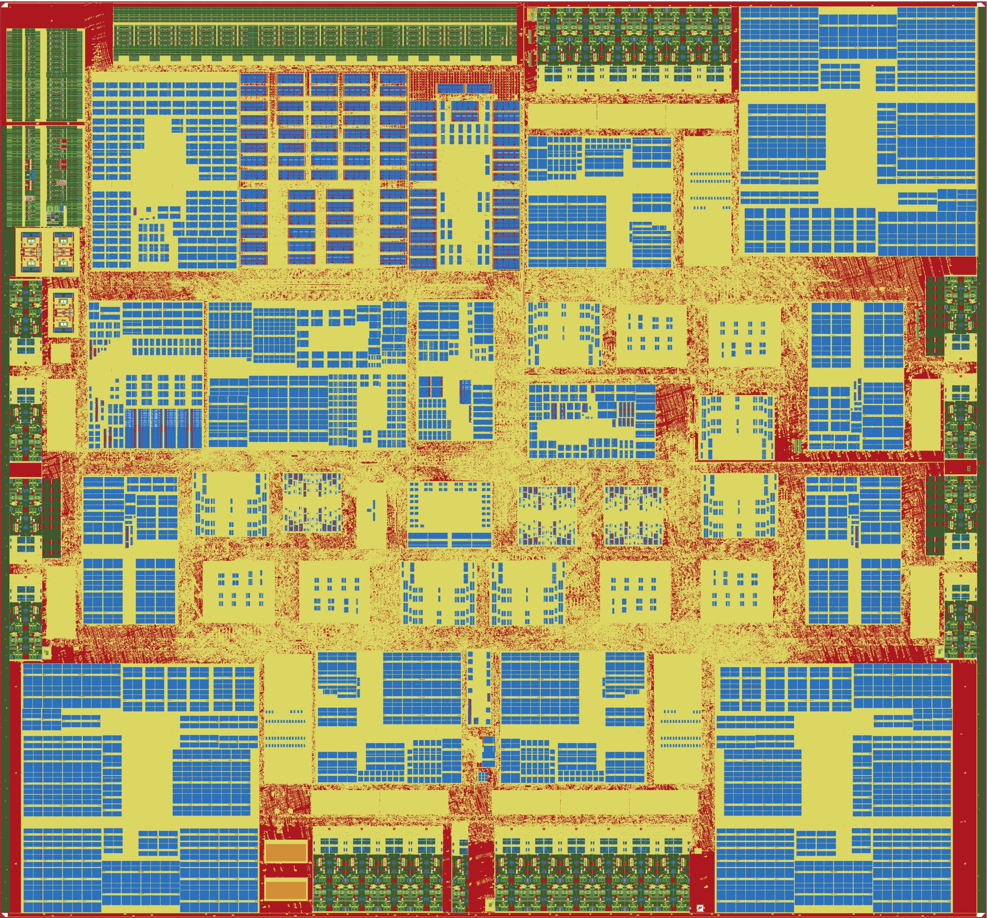
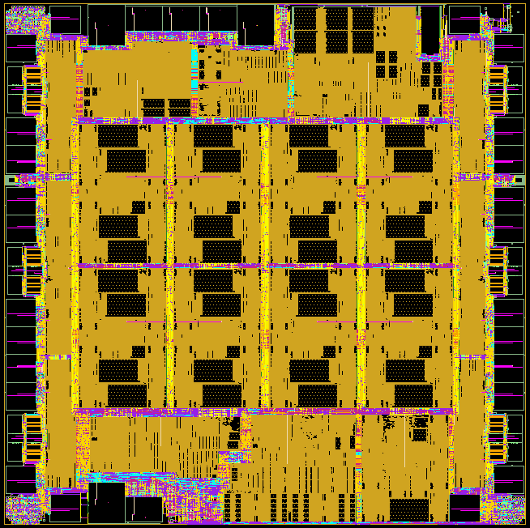
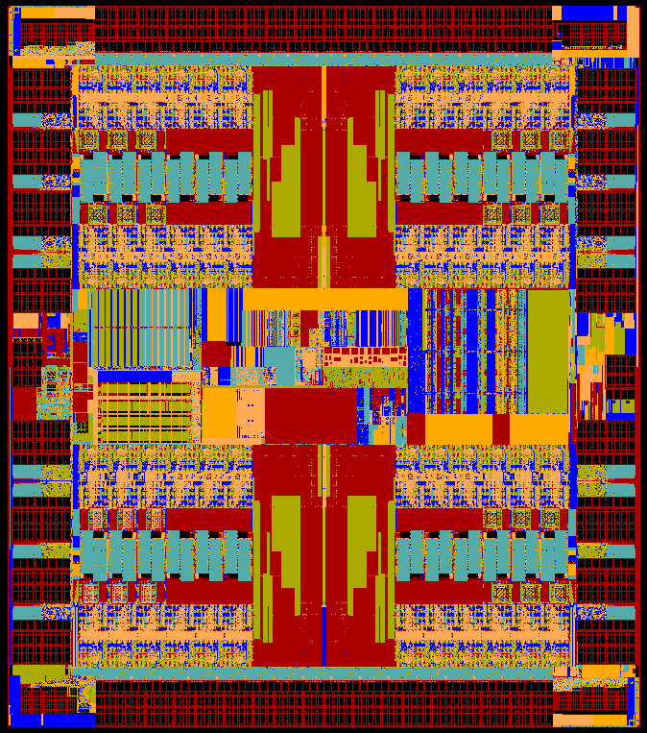
Serial I/O: About 30% of switch chip area
Intel Alta (2011)
Cisco (2011)
Ericsson Spider (2011)
Broadcom Tomahawk (2014)
Barefoot Tofino (2016)
Notes:
First, about 30% of the chip area is devoted to serial I/O. Here we have three switch chips from 2011 with the serial I/O round the edge <click> . It’s about the same for more recent chips too.

Slide 34
Switch chip area: Serial I/O
Serial I/O
Same area for each generation
1.0
Area stays same
Area stays same
Moore’s Law
Moore’s Law
Double Speed
Double Speed
Silicon
Area
Normalized
0.5
k
k+1
k+2
Semiconductor generation
Notes:
This is because with each new generation Moore’s Law lets us halve the size, but then we double the speed, which cancels it out. The same in the next generation and so on. Serial I/O has the same area for each generation.

Slide 35
30% Serial I/O
50%
Packet Processing
20%
Packet Buffer
& TM
Notes:
50% of the chip is devoted to packet processing, and about 20% to the packet buffer & TM.

Slide 36
30% Serial I/O
Packet Processing
25% Memory
(Lookup tables)
20%
Packet Buffer
& TM
25% Logic
(Packet Processing)
Notes:
Packet processing is split in turn, equally between lookup table memory and Logic. So what happens over each generation to the lookup tables and the packet buffers?

Slide 37
Switch chip area: Memory (Tables and Buffer)
Memory
Same area for each generation
1.0
Area stays same
Area stays same
Moore’s Law
Moore’s Law
Double Storage
Double Storage
Silicon
Area
Normalized
0.5
k
k+1
k+2
Semiconductor generation
Notes:
It stays the same too. In each generation Moore’s Law halves the memory area, but we always increase the capacity of tables and buffers, which cancels it out. It’s the same in the next generation. Memory area is the same for each generation.

Slide 38
30% Serial I/O
Packet Processing
25% Memory
(Lookup tables)
20%
Packet Buffer
& TM
Logic dictates whether “fixed function” or “programmable”
25% Logic
(Packet Processing)
Notes:
Now, and this is important, notice that the red portion - the Logic - is the only part of the chip that is different between fixed function and programmable. The lookup tables, packet buffer and serial I/O are all unaffected by whether the chip is fixed or programmable.

Slide 39
Switch chip area: Packet Processing Logic
1.0
Area goes down
Moore’s Law
Silicon
Area
Normalized
10% new features
0.5
Area goes down
Logic
Area goes down each generation
Moore’s Law
10% new features
k
k+1
k+2
Semiconductor generation
Notes:
So what happens to the Logic over time - does it stay the same too? No. It gets smaller. That’s because the number of protocols stays about the same from one generation to the next, and Moore’s Law shrinks it.
Logic area goes down each generation.

Slide 40
30% Serial I/O
Packet Processing
25% Memory
(Lookup tables)
20%
Packet Buffer
& TM
Logic dictates whether “fixed function” or “programmable”
25% Logic
(Packet Processing)
Notes:
This means in each generation, the fraction of the chip that’s Logic goes down.

Slide 41
30% Serial I/O
Memory
(Lookup tables)
Packet Processing
Packet Buffer
& TM
Logic dictates whether “fixed function” or “programmable”
Logic
(Packet Processing)
Notes:
Eventually, there is really no difference between a fixed function chip and a programmable chip.

Slide 42
30% Serial I/O
Memory
(Lookup tables)
Packet Processing
Packet Buffer
& TM
Logic dictates whether “fixed function” or “programmable”
Logic
(Packet Processing)
Notes:
In other words, a programmable chip has the same power and area - and hence the same cost as a fixed function switch.
There’s another reason too. Programmable chips are easier to design and easier to verify. Although the number of protocols only grows about 10% each generation, over many generations this adds up.

Slide 43
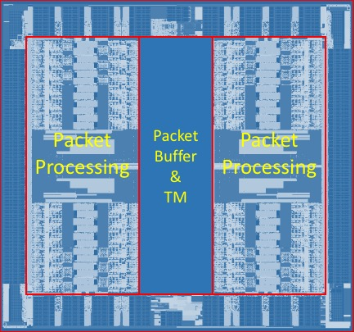
Programmable switch chips are more uniform
Cisco
Intel Alta
Ericsson Spider
Barefoot Tofino
More programmable
Notes:
Notice how much more uniform they became. It means a more compact and efficient design, and a design that’s easier to verify.
So let me summarize why the forwarding plane will be programmable in future:

Slide 44
In summary
Chip speed: We can now make programmable switch chips as fast as fixed ones.
Chip technology: The difference in chip area and power between “programmable” and “fixed function” is going away.
Chip complexity: There are now too many protocols to correctly hard-code in silicon.
New ideas: Beautiful new ideas are owned by the programmer, not the chip designer.
Level playing field: Lets us create a solid platform, an abstraction layer, upon which more will be built
To learn more, visit P4.org
Notes:
Chip technology: The difference in chip area and power between “programmable” and “fixed function” is going away.
Chip complexity: There are now too many protocols to correctly hard-code in silicon.
Chip architecture: Instruction set is now known.
Chip speed: We can now make programmable switch chips as fast as fixed ones.
New ideas: Beautiful new ideas are owned by the programmer, not the chip designer.
More reliable network: Greater visibility means failures diagnosed faster. Fixes deployed quickly.

Slide 45
Thank you!

